Slide 1
Leadership Vanuatu (LV)
Nelly Willy
Interim Director
Photo Source- EPLD website

Slide 2
OVERVIEW
What is Leadership Vanuatu
Leadership Vanuatu Vision
Leadership Vanuatu Mission
Leadership Vanuatu Strategic Objectives
Photo Source- EPLD website
Notes:
1- What is Leadership Vanuatu
2- What is the challenges Leadership Vanuatu wants to contribute to solve
3- What is the change Leadership Vanuatu wants to see happen
4- who are the stakeholders Leadership Vanuatu needs to work with to create change?
5- What will be unique about Leadership Vanuatu? Or What will Leadership Vanuatu be doing that others aren’t already doing?

Slide 3
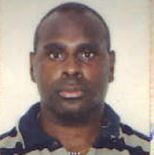
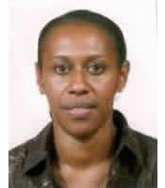
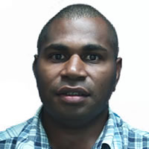
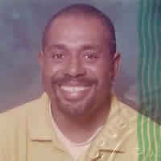
What is Leadership Vanuatu (LV)
LV is a charitable Association created by Ni Vanuatu alumni participants of various Pacific Leadership Dialogue (EPLD 2006-2010) and Commonwealth Study Conference (CSC) events
since 2007.
Photo Source- EPLD website
Notes:
These alumni (now around 10 people) have decided that it would be beneficial to develop their network and established a leadership development initiative in Vanuatu.
Emerging Pacific Leaders Dialogue is a National and Regional event aim is to strengthen the capacity of the region’s future leaders to manage challenges collaboratively, positively and creatively. The vision for the Emerging Pacific Leaders’ Dialogue came from a group of Commonwealth Study Tour Conference Alumni who saw the need for an innovative and experiential leadership development program in the Pacific.
LV Alumni attended a Leadership workshop organised by Leadership Fiji, where it brought together Leadership Fiji, Leadership Samoa, Leadership PNG Regional to share their experiences in running the Leadership Organisation.

Slide 4
OUR VISION
LEADERS
Work for the greater good of their community, organization, province or country and not for their own personal gain.
Seek and utilize the views and needs of all people that they represent
Are accountable for the decisions they make
Notes:
A Vanuatu where:
Leaders at all level- (depending on what level they are exercising leadership at)
- Leaders seek and utilise the views and needs of all people that they represent
- Leaders are accountable for the decisions they make
- Leaders work for the greater good of their community, organisation, province or country (depending on what level they are exercising leadership at) and not for their own personal gain*.
- Citizens take responsibility for their role in ensuring good leadership, are active in their engagement in decision making process and in holding leaders to account

Slide 5
OUR VISION Cont…
CITIZENS
Responsibility for their role in ensuring good leadership
Are active in their engagement in decision making process
Holding leaders to account
Notes:
- Citizens take responsibility for their role in ensuring good leadership, are active in their engagement in decision making process and in holding leaders to account

Slide 6
OUR MISSION
Leadership Vanuatu aims to create a network of emerging leaders who are empowered and passionate to address leadership challenges in Vanuatu and in so doing contribute to equitable
economic, political, social, environmental and cultural development at the community,
provincial and national level.
Photo Source- EPLD website

Slide 7
OUR STRATEGIC OBJECTIVES
1- Leadership dialogue for change
2- Developing emergent leaders
3-
Building active citizens
Notes:
LV will develop programs under 3 broad strategic objectives:
Leadership dialogue for change - To create an enabling environment for good leadership through promoting regular, dynamic and inclusive leadership dialogue which identifies a common understanding of what good leadership is in Vanuatu, advocates for accountability mechanisms to be strengthened/put in place and provides a route for direct dialogue between leaders and citizens.
Developing emergent leaders – To create a diverse, dynamic, high capacity next generation of leaders with sound leadership values and a commitment to accountability and transparency through identifying emerging leaders and supporting them in their development.
Building active citizens – To create informed citizens who actively participate in good governance, hold their leaders to account and demand transparency through provision of quality information and knowledge and opportunities for them to engage and communicate with each other and their leaders.

Slide 8
OUR STRATEGIC OBJECTIVES Cont---
1- Leadership dialogue for change
To create an enabling environment for good leadership through promoting regular, dynamic and inclusive leadership dialogue which identifies a common understanding of what good leadership is in Vanuatu, advocates for accountability mechanisms to be strengthened/put in place and provides a route for direct dialogue between leaders and citizens.
Notes:
- Create a space for dialogue between leaders and citizens.

Slide 9
OUR STRATEGIC OBJECTIVES Cont---
2- Developing emergent leaders
To create a diverse, dynamic, high capacity next generation of leaders with sound leadership values and a commitment to accountability and transparency through identifying emerging leaders and supporting them in their development.
Notes:
- Have a transparent and accountable process in place to identify emergent leaders and support them through their leadership path.

Slide 10
OUR STRATEGIC OBJECTIVES Cont---
3-
Building active citizens
To create informed citizens who actively participate in good governance, hold their leaders to account and demand transparency through provision of quality information and knowledge and opportunities for them to engage and communicate with each other and their leaders.
Notes:
To provide citizens with information on what is our role being citizen for a country, provide information on decision that are taken by our leaders and why it is Important for citizen to engage with their leaders and to hold their leaders accountable for their decisions.
To bring this presentation to an end I would like to emphasis that Leadership Vanuatu is a new organisation formed by very senior, dedicated, professional, knowledgeable and full time workers, who were alumni for the EPLD and CSC that feels we have a role to engage with our leaders and citizens for the betterment of our small island state, Vanuatu for the public good of our nations. We therefore would like to invite feedback on this presentation and continuous dialogue on the development of this leadership organisation.

Slide 11
Thank You
Photo Source- EPLD website

